Slide 1
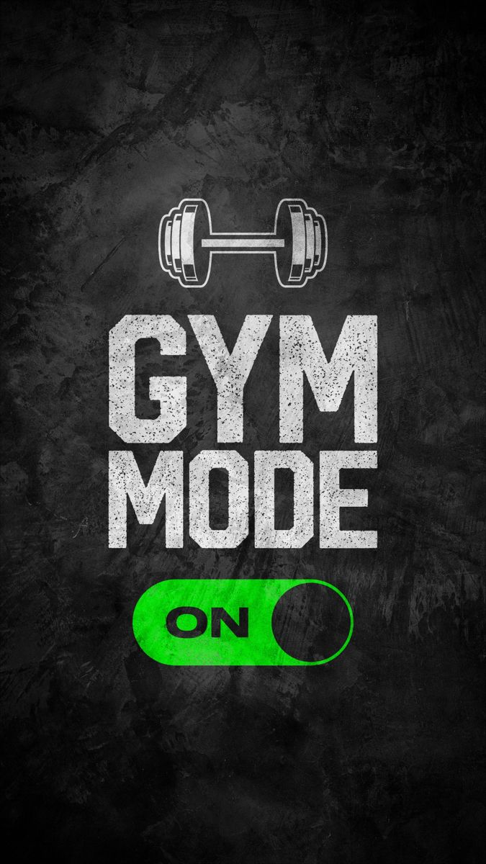
Gym Members Exercise Tracking Analysis
Presented By:-Ankit Rajak
Project File:-Gym Project Analysis

Slide 2

Introduction:-
The gym industry plays a vital role in promoting health, fitness, and well-being, catering to individuals with diverse fitness goals. This gym project analysis aims to explore key performance metrics and trends within a fitness center, focusing on membership demographics, workout preferences, attendance patterns, and member progress. By analyzing data on member engagement, workout types, and personal training sessions, the project seeks to gain insights into how the gym can improve customer satisfaction, boost retention rates, and optimize services.
Through this analysis, the project will evaluate the effectiveness of different workout programs, identify peak gym usage times, and assess member performance based on gender, age, and fitness levels. Additionally, the analysis will help uncover areas for improvement, such as equipment utilization, space management, and personalized training needs. The goal of this project is to provide actionable insights that enhance the gym’s operational efficiency, create a better fitness environment, and support members in achieving their fitness objectives.

Slide 3
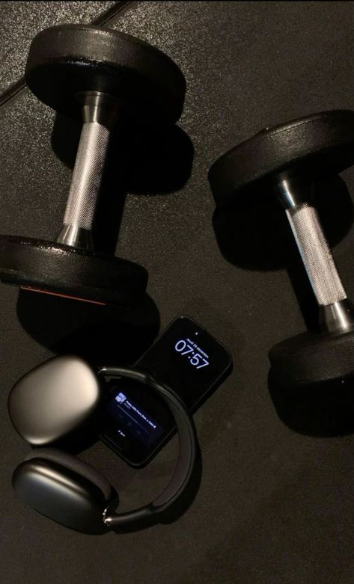
Objective:-
A gym's primary objective is to promote physical fitness, health, and well-being by providing a range of equipment, facilities, and classes designed to cater to different fitness levels and goals. It aims to create a supportive environment where members can improve their strength, endurance, flexibility, and cardiovascular health. The gym also focuses on helping individuals achieve specific goals, such as weight loss, muscle gain, or overall wellness. Additionally, gyms often provide guidance from trained professionals to ensure safe, effective workouts while fostering motivation, discipline, and a balanced lifestyle through consistent physical activity and community engagement.

Slide 4

Key Questions:-
1.How many Male And Female Member of the Gym.
2.Workout Type Preference By Gender.
3.Total Calories Burned By Workout Type.
4.Average Weight (kg) And Height (m) By Gender (Ages 18-35).
5.Average Weight (kg) And Height (m) By Gender (Ages 36-59).
6.BPM Statistics By Gender (Ages 18-35).
7.BPM Statistics By Gender (Ages 36-59).
8.Total Water Intake By Gender And Water Intake (Liters).
9.Fat Percentage Count By Gender And Experience Level.

Slide 5
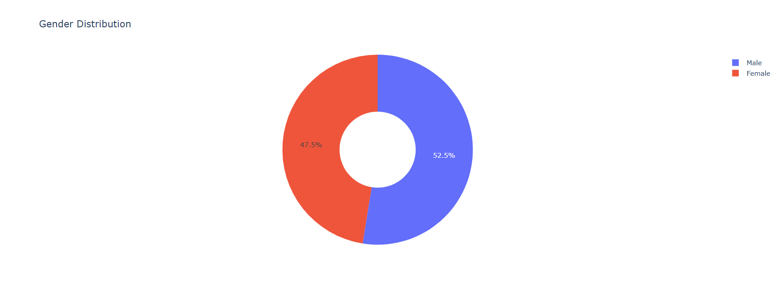
How many Male And Female Member of the Gym.
Observation:-Emphasizing the inquiry about the gender distribution of gym members. It is likely part of a report or data analysis that aims to quantify and compare the number of male and female gym members. However, specific numbers are not provided in the image.

Slide 6
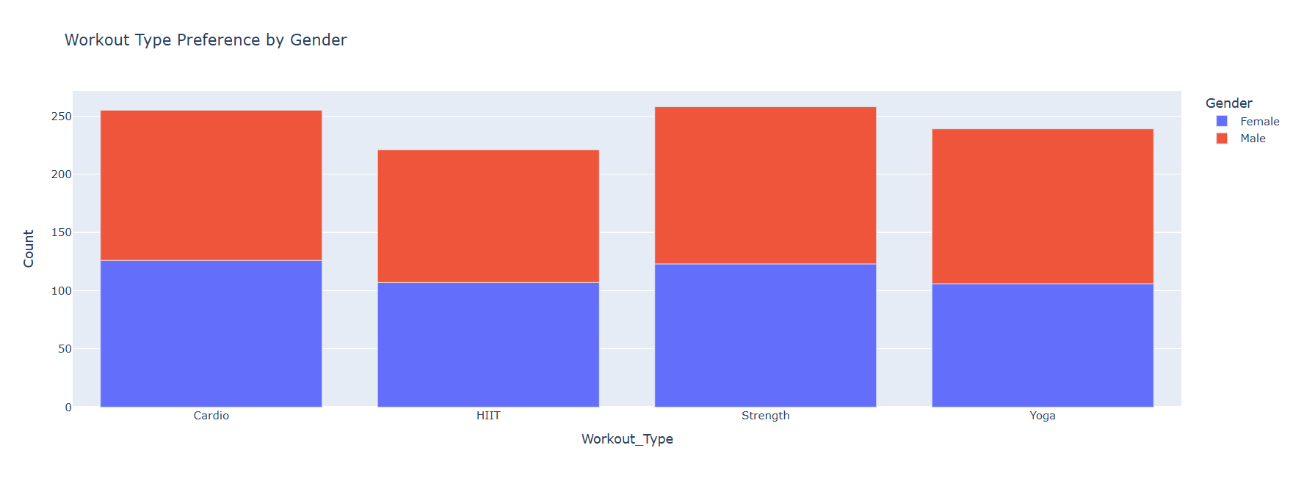
Workout Type Preference By Gender.
Observation:-It suggests an analysis or comparison of different workout types preferred by males and females at the gym. The key observation likely revolves around identifying which workout routines (e.g., cardio, strength training, yoga, etc.) are more popular among male or female members, helping understand gender-specific fitness preferences.

Slide 7
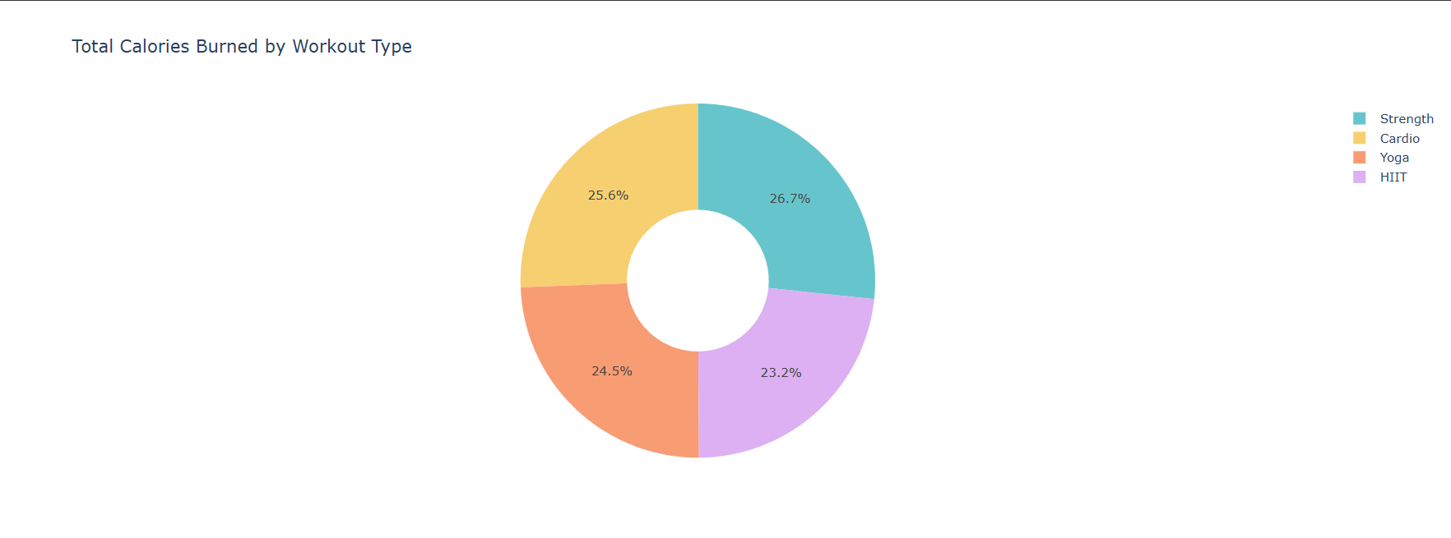
Total Calories Burned By Workout Type.
Observation:-The key observation would focus on identifying which workouts (e.g., cardio, strength training, HIIT, yoga) result in the highest and lowest calorie burns. This information helps in understanding the effectiveness of various exercises for energy expenditure and weight management, providing insights into which workouts are more intense or efficient for burning calories.

Slide 8
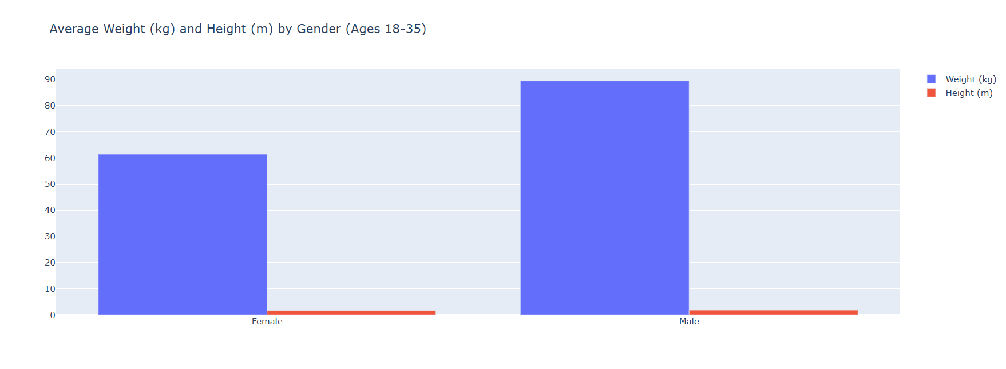
Average Weight (kg) And Height (m) By Gender (Ages 18-35).
Observation:-An analysis focused on comparing the average weight and height of males and females within the age range of 18 to 35. The key observation would involve identifying any noticeable differences in the average weight and height between genders, which could provide insights into general body composition trends in this age group. This information could be useful for fitness programming or health assessments based on gender-specific physical characteristics.

Slide 9
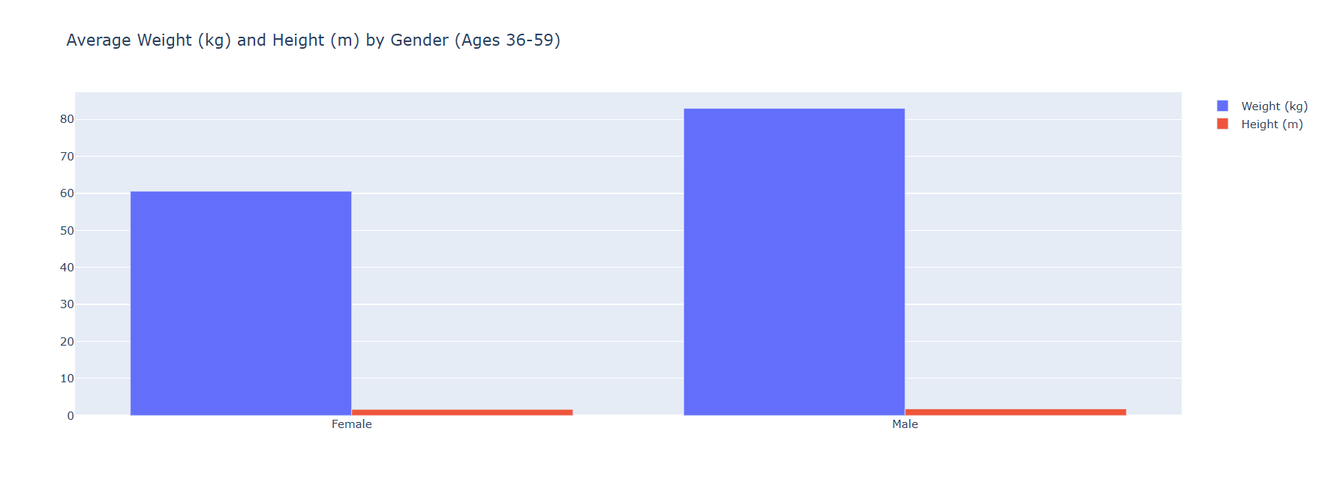
Average Weight (kg) And Height (m) By Gender (Ages 36-59).
Observation:-An analysis of the average weight and height of males and females within the age range of 36 to 59. The key observation would likely focus on identifying differences in average weight and height between genders in this age group. Additionally, comparing these values with younger age groups (e.g., 18-35) could highlight trends such as changes in body composition, weight gain, or loss of height due to aging. This information is valuable for understanding age-related physical changes and tailoring fitness or health recommendations accordingly.

Slide 10
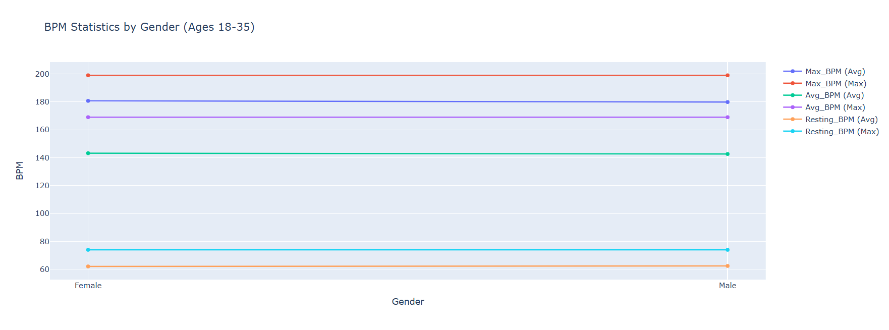
BPM Statistics By Gender (Ages 18-35).
Observation:-An analysis of Beats Per Minute (BPM) or heart rate for males and females in the age range of 18 to 35. The key observation would involve comparing the average resting or active heart rates between genders. You may notice trends such as males having slightly lower resting BPM on average compared to females, or how exercise affects heart rates differently by gender. Additionally, this could reveal insights into cardiovascular health, fitness levels, and differences in heart rate recovery after workouts between males and females in this age group.

Slide 11
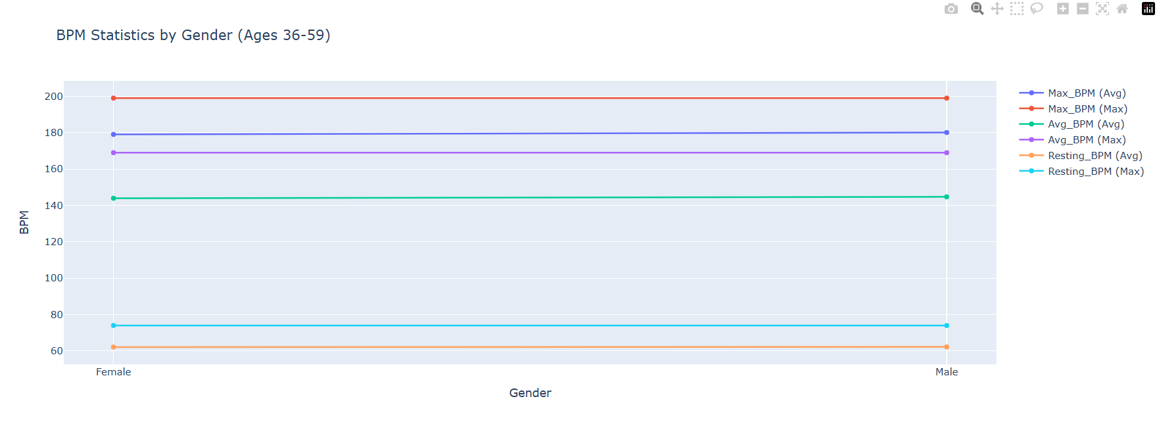
BPM Statistics By Gender (Ages 36-59).
Observation:-The analysis of Beats Per Minute (BPM) or heart rate data for males and females within the 36-59 age group. The key observation would likely focus on comparing resting or active heart rates between genders and detecting potential trends or variations. In this age group, factors such as fitness levels, lifestyle, and age-related cardiovascular changes may contribute to differences in BPM. You may also observe that average resting BPM might be higher compared to younger age groups (18-35), reflecting changes in heart health and fitness levels as people age.

Slide 12
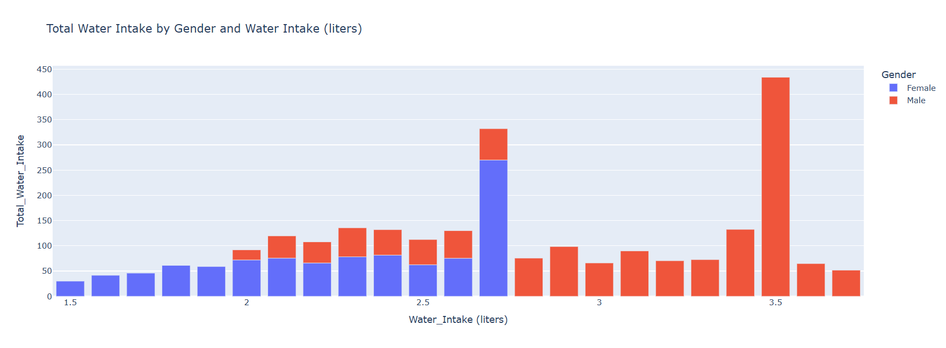
Total Water Intake By Gender And Water Intake (Liters):-
Observation:-An analysis of the total amount of water consumed by males and females, likely presented in liters. The key observation would focus on identifying any significant differences in water intake between genders. You may notice patterns such as males typically consuming more water due to higher body mass or physical activity levels, or that females might have different intake levels based on lifestyle or hydration needs. This data can help in understanding hydration habits and guiding recommendations for daily water consumption based on gender.

Slide 13
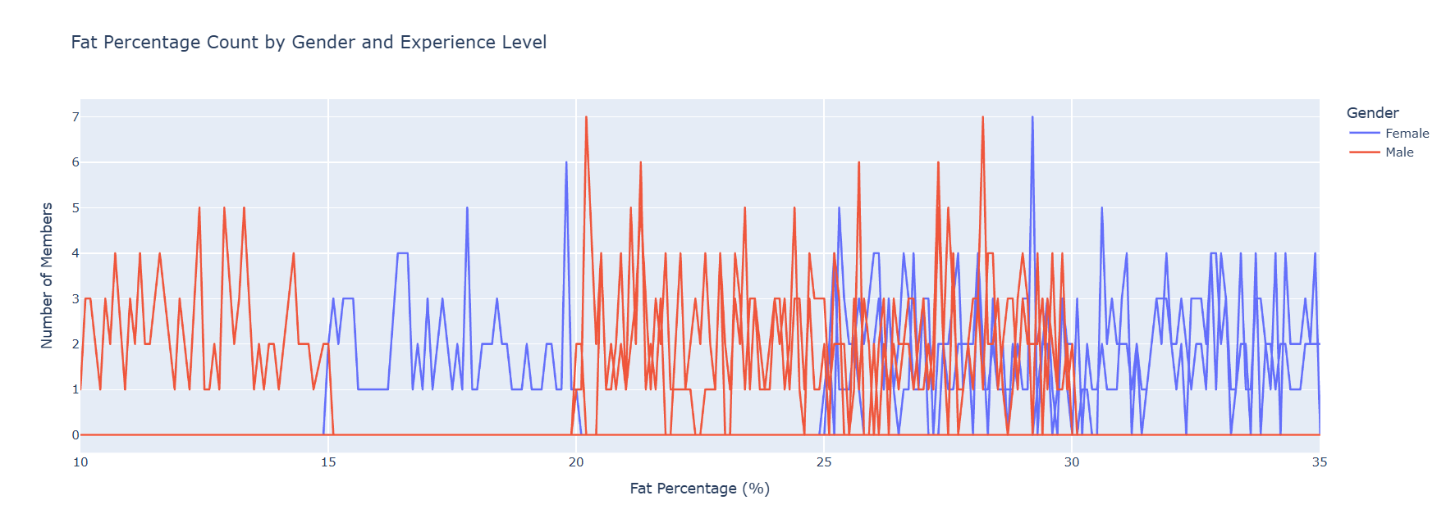
Fat Percentage Count By Gender And Experience Level:-
Key Observation:-
An analysis of body fat percentage across genders and categorized by experience level (e.g., beginner, intermediate, advanced). The key observation would likely involve identifying trends such as:
Gender differences: Males may tend to have lower body fat percentages compared to females due to physiological differences.
Experience level impact: As experience levels increase (e.g., advanced gym-goers), body fat percentages might decrease, reflecting improved fitness and conditioning over time. This analysis could highlight how both gender and experience in fitness affect body composition.

Slide 14

Conclusion:-
The gym members' exercise tracking analysis reveals key patterns in workout habits and performance. Data shows consistent participation in high-intensity training, with a growing interest in strength-based exercises. However, many members struggle with maintaining regular attendance and progression over time. Personalized tracking tools and workout plans could help improve retention and results. Additionally, integrating more variety in exercise options, such as group fitness classes or new equipment, could enhance member engagement. Overall, the analysis suggests that personalized attention and diversified offerings are key to boosting member satisfaction and achieving long-term fitness goals.

Slide 15
THANK YOU

